Slide 1
Ultrabrand’s Journey to a Smarter Web Analytics Product Offering
Case analysis by

Slide 2
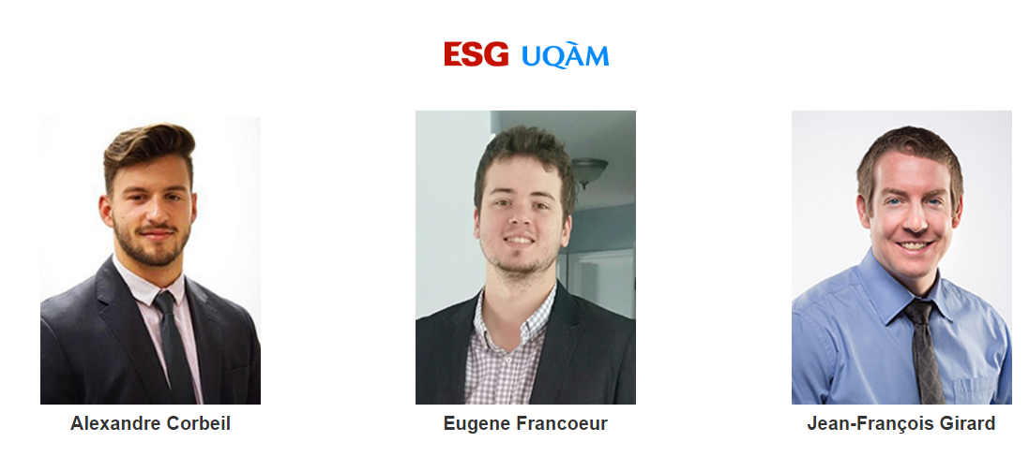
ESG-UQAM University

Slide 3
Plan
Case and Ultrabrand analysis
Increasing needs of web analytics
Descriptions of the 3 options :
Inspectlet : White-Label
Whitecap : Custom-built
BI analyst solution
4. Recommandation
5. Implementation and Action planning

Slide 4
Ultrabrand Ltd.
Creation in January 2010
Net income of 95,000$ in 2014
More than 75% of customers are in the USA, the rest are in Canada
High-end brand image, charge $15,000 per site (competitors $2,000)
Increasing needs for web analytics in website development
5 areas of digital branding
Web design
Content Management
Web analytics and reporting solutions
Software and app development
Voiceover services

Slide 5
Plan
Case and Ultrabrand analysis
Increasing needs of web analytics
Descriptions of the 3 options :
Inspectlet : White-Label
Whitecap : Custom-built
BI analyst solution
4. Recommandation
5. Implementation and Action planning

Slide 6
Web Analytics
Give a competitive advantage in terms of consumer behavior
Reporting capabilities that can provide major insights
KPI :
Conversion rates
Visitors
Traffic sources
Cost analysis
Increase decision making process for marketing goals
84% of American businesses are using some form of web analytics

Slide 7
Web analytics at Ultrabrand
Approximately, 50% of Ultrabrand’s clients indicated that they wanted web analytics
Possibilities of losing a big client : Xu-Dermatology
Potential revenue $15,000 for every potential client that look their business elsewhere
Lacklustre of Google Analytics:
Very difficult to use and interpret
Overwhelming user interface
Limited functionality

Slide 8
Plan
Case and Ultrabrand analysis
Increasing needs of web analytics
Descriptions of the 3 options :
Inspectlet : White-Label
Whitecap : Custom-built
BI analyst solution
4. Recommandation
5. Implementation and Action planning

Slide 9
Inspectlet : White-Label
Advantages
Used by some of the most popular website in the world
Represent a great cost/revenue ratio on the short term
under 2 years
Quick installation
No annual subscription required
Offers a complete service support

Slide 10
Inspectlet : White-Label
Disadvantages
Monthly fee as long as using the software
Not owner of the software code (dependence)
General solution may require changes in business practices

Slide 11
Whitecap : Custom built
Advantages
90% of customer retention
Easy user interface
Custom build to fit Ultrabrand’s needs
Would allow Ultrabrand to compete in crowded marketplaces
The code of the solution is own 100% by Ultrabrand
Whitecap offers 24/7 coverage for clients

Slide 12
Whitecap : Custom built
Disadvantages
Deployment will take time (requirements analysis + design)
Obligation to pay $12,000 in consultation
Custom build software : $50,000
Total cost of $62,000 represent 65% of the company net income

Slide 13
BI analyst solution
Advantages
Continuity of actual services
Personalized reporting for each client
Opening paths to several new and reoccurring revenue streams for the future
Disadvantages
Risks that the BI analyst won’t fit Ultrabrand’s needs
Delay (recruitment + training of the analyst on best practices)
Less potential benefits in the short, medium and long term

Slide 14
Plan
Case and Ultrabrand analysis
Increasing needs of web analytics
Descriptions of the 3 options :
Inspectlet : White-Label
Whitecap : Custom-built
BI analyst solution
4. Recommandation
5. Implementation and Action planning

Slide 15
Recommendation – Short term
Inspectlet (short term solution)
Quick implementation may retain Xu-Dermatology
Bolstering the company’s main lacklustre (web analytics)
Ultrabrand can generate quick working capital, so they can cover the consultant costs of the custom-made solution
No annual subscription required
Take advantage of the growing trend of web analytics

Slide 16
Recommendation – Mid to long term
Whitecap (mid and long-term)
Offer a web analytics solution that fits client needs
Easy user interface
Increase company valuations as an asset when it comes to sell
Generate the best revenue on the mid and long term over the other solution
Would allow Ultrabrand to keep his leading position

Slide 17
Challenges/risks turn into opportunities
Challenges/risks
Failure of the Whitecap option : less profit in the mid to long term
Having to pay the $12,000 in consultation without implementing the solution
Opportunities
Financing the more expensive (Whitecap) option with another one (Inspectlet)
Open opportunities to compete in new crowded marketplaces
Possibility to sell the company for a higher value

Slide 18
Plan
Case and Ultrabrand analysis
Increasing needs of web analytics
Descriptions of the 3 options :
Inspectlet : White-Label
Whitecap : Custom-built
BI analyst solution
4. Recommandation
5. Implementation and Action planning

Slide 19
5. Implementation and Action planning

